Slide 1




Digital Transformation – Learning Culture
Vera Gramkow
Global Head of Talent & Performance Development n
Twitter: @GramkowV

Slide 2



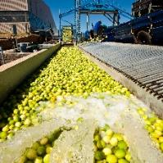
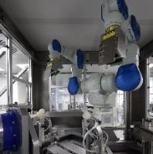

To drive Digital & Business Transformation…
Customer Experience
New Business Models
  Improve customer experience, add digital products and services
Digital Farming
Digital Health
Digitizing Operations
… we need to use data!
e.g. Blockchain enabled
traceability (food supply,
production processes)
e.g. Artificial
intelligence
& robotics

Slide 3
Megatrends
Population growth and demographic change
Digitalization
Pressure on ecosystems
Technological leaps
Societal changes and changing face of the customer
All of this will lead to significant changes:
New jobs will emerge, new skills will be required, and each of us will need to learn…

Slide 4
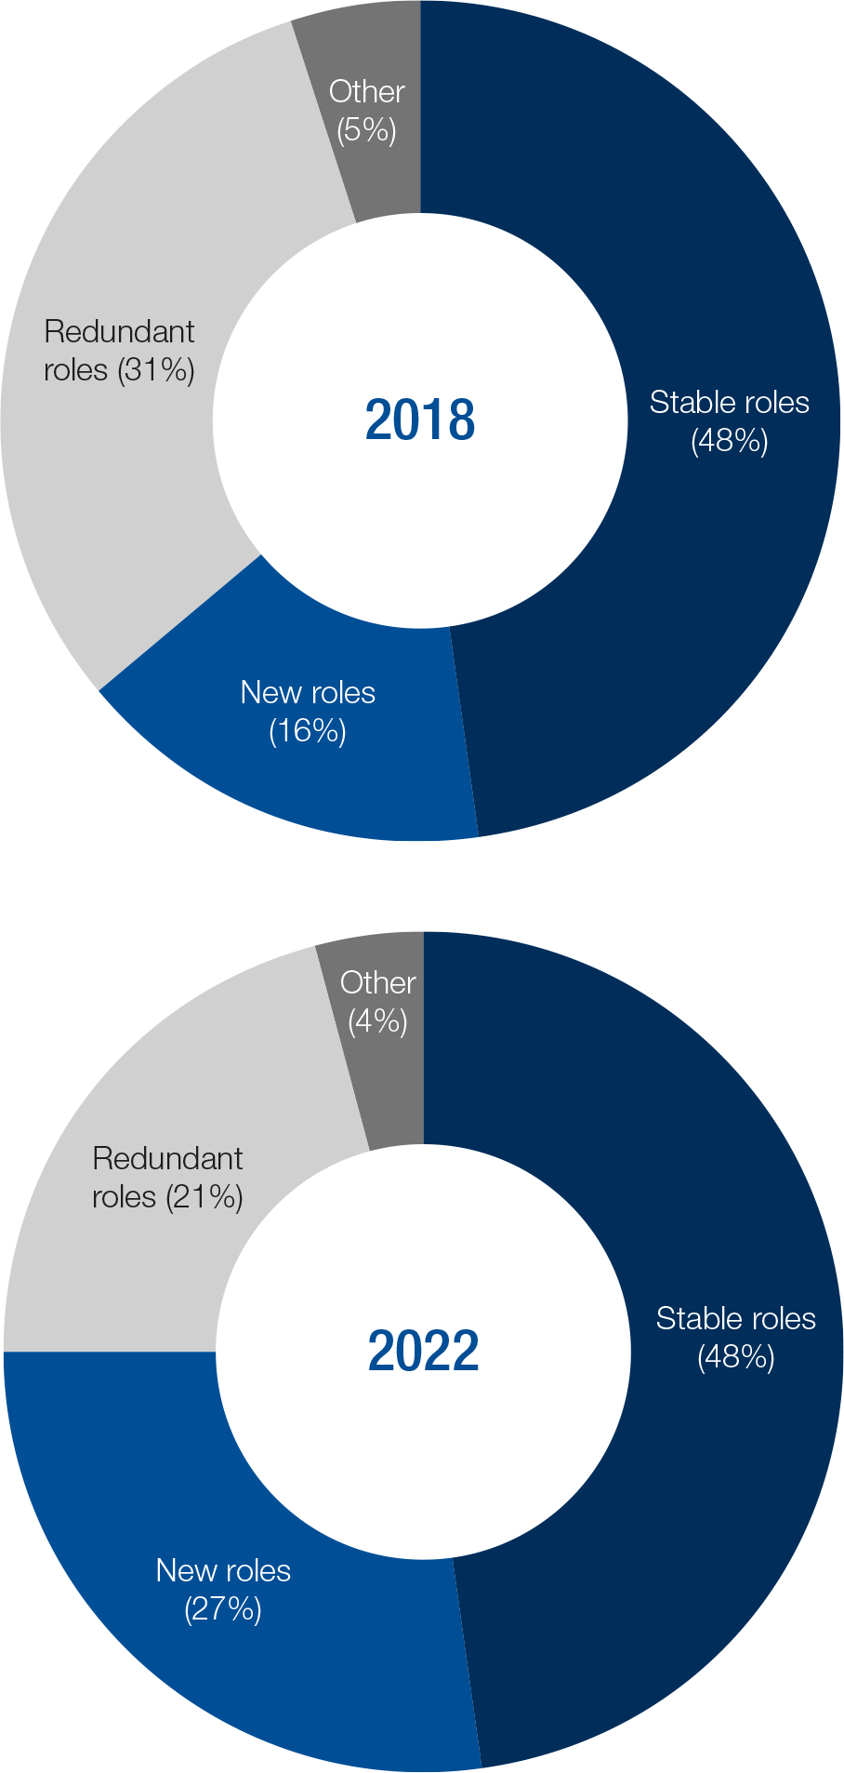
The Future of Jobs Report 2018 – World Economic Forum
Share of stable, new and redundant roles, 2018 vs. 2022 (projected)
Figure 3: Share of stable, new and redundant roles, 2018 vs. 2022 (projected)
Source: Future of Jobs Survey 2018, World Economic Forum

Slide 5
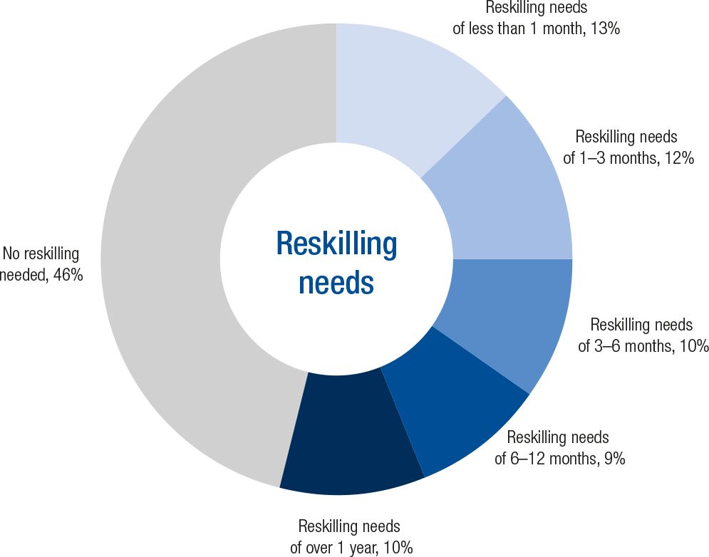
The Future of Jobs Report 2018 – World Economic Forum
The external trends clearly show the urgent need for learning new skills and capabilities
Figure 7: Expected average reskilling needs across companies, by share of employees, 2018–2022, Source: Future of Jobs Survey 2018, World Economic Forum.

Slide 6
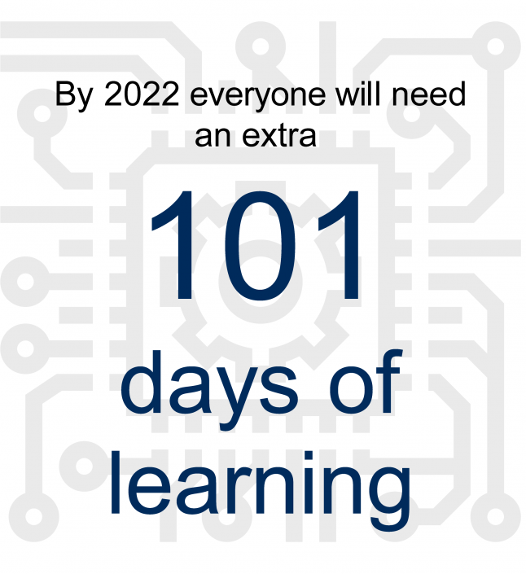



“Lifelong learning is essential…
Quelle: Datenreport 2016 (Sozialbericht) der Bundeszentrale für politische Bildung
But the truth is that people aged 30 to 44 spend just
9 minutes a day
(=20,6 days in 5 years)
on average on improving their qualifications.
And for people aged 45 to 64, the figure is even lower only 4 minutes
(=9,17 days in 5 years)
vs
Source: Future of Jobs Survey 2018, World Economic Forum.

Slide 7
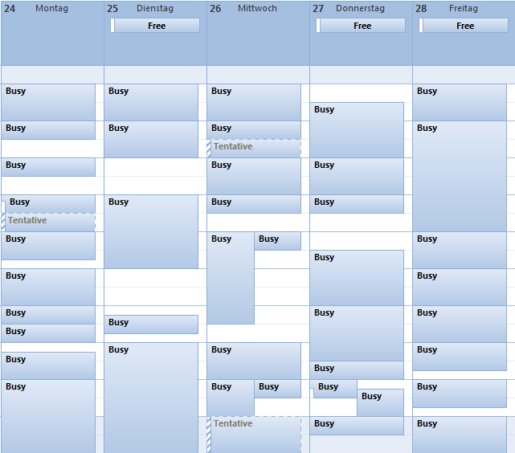
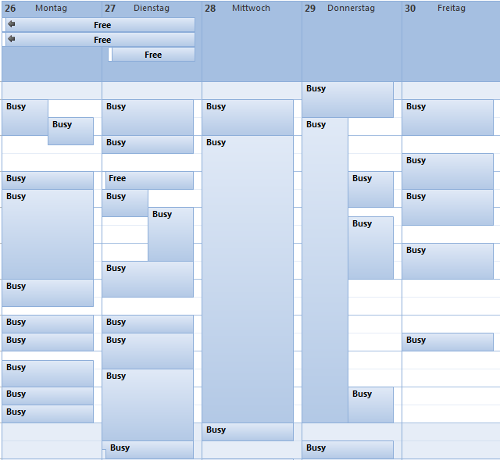
How does your calendar look like…
….
Reflection: How often did you make conscious time for learning last week?
Emails….
Emails….
Emails….
Important Learning
Emails….
Emails….
Emails….
or?
Emails….
Emails….
Emails….
Emails….
Emails….
Important Learning
Emails….
Emails….
Emails….
Lifelong Learning is not a #Buzzword any longer! Better starts with YOU!
Emails….
Don´t mix up “Available any time” with “When I have time…”
Emails….

Slide 8

Accessible /
Push & Pull
Feedback / Sharing is Caring
Reward Continuous Learning
Lead by example
Personalized
8
/// Advancing Digital at Bayer /// Data as an Asset Convention /// September 2019

Slide 9


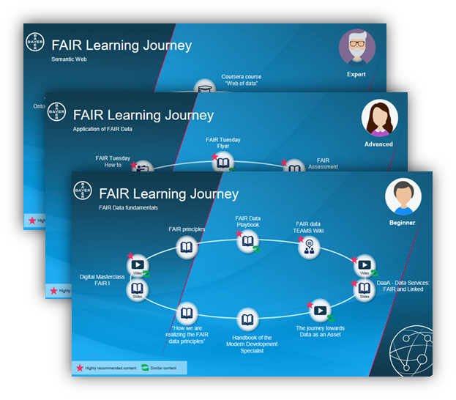





For
Everyone
Data Learning Journeys
Ready to use
24/7 access to online trainings & resources through the e-learning program and Bayer specific masterclasses
The Digital Masterclasses improve the ability of the organization to learn from its own experts and use cases, as well as external experience and perspectives. 10 episodes available, Top three videos with the most views:
1. Human Centered Data Science / 2. What is AI? / 3. Neural Networks
The Advancing Digital Learning Journey is designed for everyone who is passionate to understand the most important topics of the digital transformation at Bayer. We leverage different techniques & methods, content is tailored to your expertise level.
Almost 4500 eLearning have been accessed, top three courses:
1. Agile Principles and Methodologies
2. Best Practices for Digital Transformation
3. Embracing an Agile Culture for Business Growth
Expert
Advanced
Beginner
Go/datalearningjourneys

Slide 10



#LearningCulture
  Wat is your biggest lever in achieving a learning culture?
What do your employees say about your culture, in particular your learning culture?
  Do you know the skills that are necessary for future business success?
/// Advancing Digital at Bayer /// Data as an Asset Convention /// September 2019

Slide 11

Thank you!
Vera Gramkow
Global Head of Talent & Performance Development n
Twitter: @GramkowV

Slide 12
Forward-Looking Statements
This presentation may contain forward-looking statements based on current assumptions and forecasts made by Bayer management.
Various known and unknown risks, uncertainties and other factors could lead to material differences between the actual future results, financial situation, development or performance of the company and the estimates given here. These factors include those discussed in Bayer’s public reports which are available on the Bayer website at http://www.bayer.com/.
The company assumes no liability whatsoever to update these forward-looking statements or to conform them to future events or developments.

