Slide 1
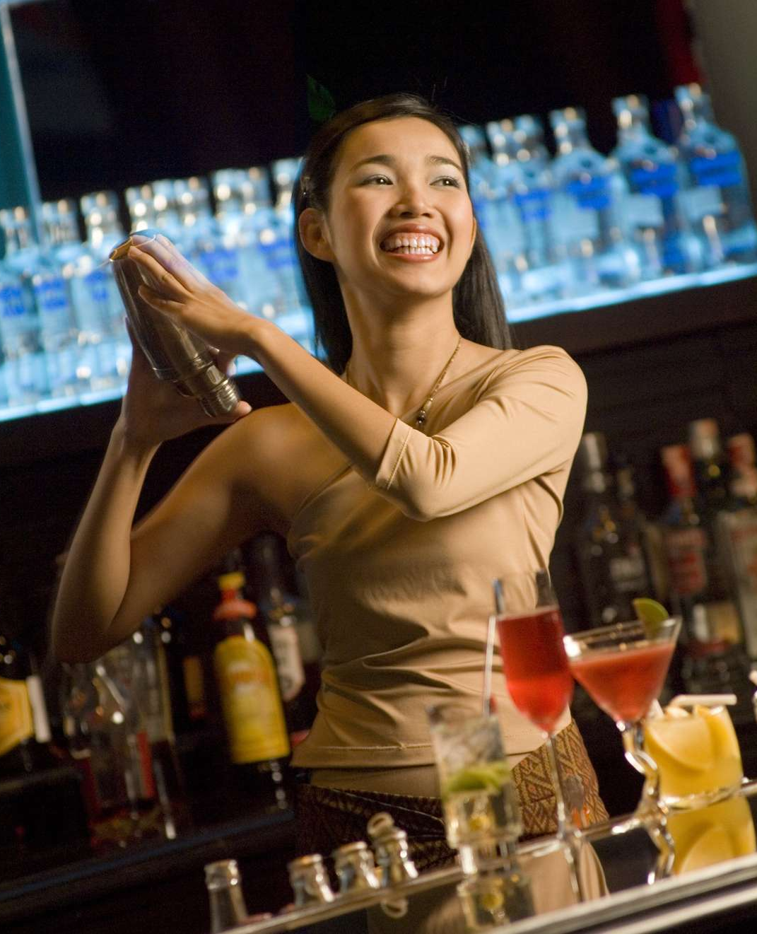
Raytheon symposium 2019
Leveraging L&D to overcome the skills shortages
Heike Kober
Notes:
Leverage this title slide when presentation is going to be shown on-screen. Insert your image into the IMAGE PLACEHOLDER area to customize this slide.

Slide 2
Learning Café
Apprenticeships: an age-old solution to 21st century challenges
Notes:
Section dividers are used to split up presentations into more digestible pieces. Leverage this title slide when presentation is going to be shown on-screen. Insert your image into the IMAGE PLACEHOLDER area to customize this slide.

Slide 3
COMPANY OVERVIEW:
Hilton is a leading global hospitality company with 17 brands
Our brands are comprised of:
Nearly 5,900 properties
More than 939,000 rooms
In 114 countries and territories
Notes:
As of June 30, 2019, Hilton's development pipeline totaled nearly 2,490 hotels consisting of approximately 373,000 rooms throughout 109 countries and territories, including 37 countries and territories where Hilton does not currently have any open hotels
100 years history – tradition combined with innovation / huge legacy to live up to, which is why we see ourselves as industry leaders

Slide 4


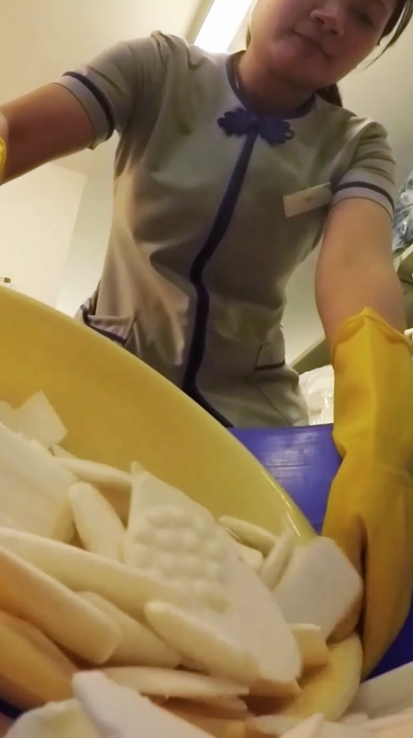
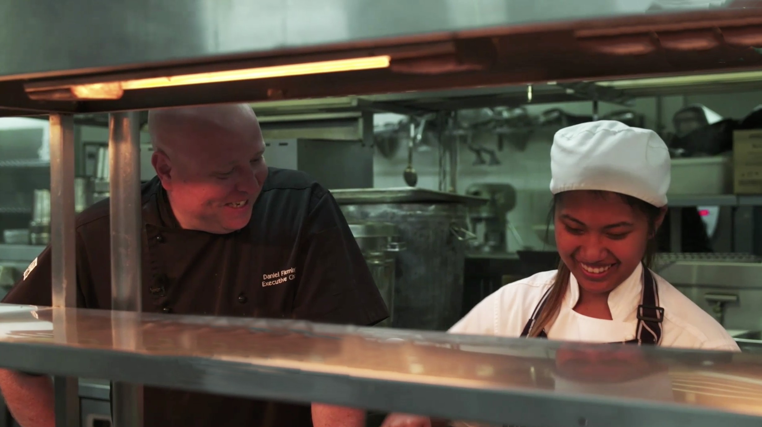


Goals
FOR 2030
DOUBLE
INVESTMENT INTO
Social Programs
CUT
OUR
Environmental Footprint
50%
ZERO
61%
REDUCTION IN
SOAP TO
Water Use
Landfill
REDUCTION OF
Environmental Footprint
Carbon Emissions
Carbon Emissions

Slide 5



Slide 6
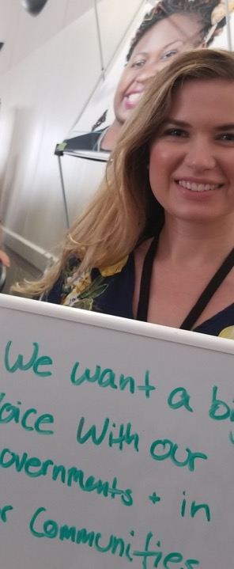
What is the impact of the future of work on programs and how do we find the right balance between the needs of the economy, business and the employee?

Slide 7
What is work?
Service and IP based economy
Social, Integrative and hybrid skills
The Future of Work and impact on programs
Who will do the work?
F/P Timers
Joint Ventures
Contractors
Freelancers
Gig Workers
Crowd Funders
Millennials
Where is the work done?
Network of Teams
Culture, Purpose and Inclusion
Learning and personal re-invention
Hack careers
Design thinking to de-design jobs, work and leadership

Slide 8
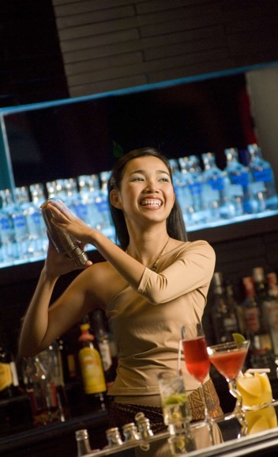

How do we ensure that apprenticeships are fit for purpose and can adapt to the speed of change and what are the essentials in delivery models to maintain quality?

Slide 9
Apprenticeship – Definition / purpose ??
An apprenticeship is a system of training a new generation of practitioners of a trade or profession with on-the-job training and often some accompanying study (classroom work and reading).
Apprenticeships can also enable practitioners to gain a license to practice in a regulated profession.
Most of the apprentices training is done while working for an employer who helps the apprentices learn their trade or profession, in exchange for their continued labor for an agreed period after they have achieved measurable competencies.
Apprenticeship lengths vary significantly across sectors, professions, roles and cultures. People who successfully complete an apprenticeship in some cases can reach professional certification level of competence (fellowship).
In others can be offered a permanent job at the company that provided the placement. Although the formal boundaries and terminology of the apprentice/journeyman/master system often do not extend outside guilds and or trade unions, the concept of on-the-job training leading to competence over a period of years is found in any field of skilled labor.

Slide 10
How do we ensure that apprenticeships are fit for purpose and can adapt to the speed of change and what are the essentials in delivery models to maintain quality?

Slide 11
Based on this mornings discussion – please complete the last sli.do poll.

Slide 12
Thank You

