Slide 1

Building a Talent Acquisition Strategy for global Expansion
HR Executive Roundtable | Corporate Leaders & ADP | Frankfurt/M. | March 17, 2020
Prof. Dr. Armin Trost | Furtwangen University

Slide 2
What is your
Talent Acquisition Strategy?

Slide 3
Which parts of all talent acquisition activities are critical to the competitive advantage of your company and its long-term success?
What are major challenges in talent acquisition and how does your company allocate resources to these?
Related to the given challenges and goals, what are key approaches in talent acquisition?
How are those key approaches strategically aligned given the internal cultural and structural context?
Who is responsible for what both in terms of local/global roles and HR versus business line?

Slide 4
low
Demand
small
Talent Availability
big
high
low
high
Strategic Relevance

Slide 5
Specialist Hiring
Strategic Hiring
low
Difficult Mass Hiring
Demand
small
Talent Availability
Simple Hiring
big
high
low
high
Strategic Relevance

Slide 6
EVP
Job
Ads
Active Sourcing
Executive Search
Talent Community
Hirings
per FTE
Line Engagement
Priority
50
Efficiency & validity
general
20
Scale & effectiveness
supportive
broad
10
Effectiveness
Job-spec.
supportive
pushed
5
Excellence
C-Level

Slide 7
Classifying needs
Hiring scenarios definition
Definition of approaches
Operation
Design
Responsibilities
Piloting
Execution Optimization
Scaling

Slide 8
Central
planning and control
B
Hire
& pay
A
Institutionalization
C
People-centered
enablement

Slide 9
Intense Specialist Hiring Action Plan (Example)
Setup a project-team consisting of sourcing-experts (HR) and the business line
Make sure, all project team members have at least 10% of their working time available for this particular specialist hiring project
Run workshop and interviews with current job incumbents to develop a strong and job-specific EVP related to the job in question
Together with the line, define gold criteria for selection. Focus on as few requirements as possible (competence versus potential)
Have a referral (rolodex) workshop with line representatives to identify potential candidates
In the project team identify relevant channels and media to attract the relevant target groups
With the business line agree on ways and responsibilities to approach potential candidates
Prepare selected colleagues in the business line for active sourcing activities (e.g. approaching candidates)
Have enough time-slots for candidate-calls and interviewing reserved before sourcing activities will actually begin

Slide 10
international
multinational
global
Dictate, export
& control
Don’t care & focus on headquarter
Listen, connect
& facilitate
Follow
Just act on local responsibility
Joint responsibility on shared matters
According to: Bartlett, C.A. & Ghoshal, S. (2002). Managing Across Borders. Harvard Business School Press.

Slide 11
high
Volume
low
Hiring difficulty
high
low
low
Commonality
of needs
high

Slide 12
Specialist/Strategic Hiring
Common difficult mass hiring
high
Local difficult
mass hiring
Volume
low
Hiring difficulty
Simple Hiring
high
low
low
Commonality
of needs
high

Slide 13
Common difficult
mass hiring
Local difficult
mass hiring
Specialist/strategic hiring
Simple hiring
Share global infrastructure (e.g. ATS) to increase efficiency
Provide global templates, material and formats for local HR marketing and selection (toolbox)
Build a global employer brand with focus on bottleneck function to increase leverage
Support local function in building local employer brands
Share best practices on talent communities
Support local referral programs
Provide global network of executive search consultancies and recruiting agencies
Share best practices on active sourcing

Slide 14
Which parts of all talent acquisition activities are critical to the competitive advantage of your company and its long-term success?
What are major challenges in talent acquisition and how does your company allocate resources to these?
Related to the given challenges and goals, what are key approaches in talent acquisition?
How are those key approaches strategically aligned given the internal cultural and structural context?
Who is responsible for what both in terms of local/global roles and HR versus business line?

Slide 15
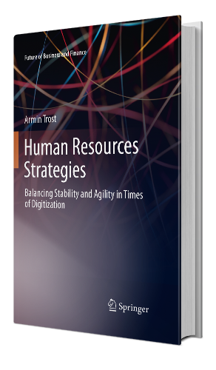



Prof. Dr. Armin Trost
Im Keltergarten 29 | 72070 Tübingen | Germany
M +49 151 226 44480 | T +49 7071 7704686
mail@armintrost.de | www.armintrost.de

